Slide 1
Kanban
Problem
How to manage a process workflow?
Difficulty
Some training required
Kanban is a workflow management method to organize, manage, and improve processes.
A Kanban board represents a workflow. Each column represents a task and each Kanban card represents a work item.
A Kanban board is a real-time information repository and it identifies system bottlenecks
Using WIP (work-in-progress) limits for tasks ensures only a manageable number of items are in progress at one time.
Limiting WIP creates a “pull system.” This is like a grocery store whose shelves are only stocked as needed.
A workflow visualization and management scheme
Existing process
Kanban Process
Ensure the business process is clearly defined, published, and socialized.
Design an appropriate Kanban board.
Perform the six Kanban practices while executing the business process:
Visualize the workflow
Limit work in progress (WIP)
Measure and manage flow
Make process policies explicit
Implement feedback loops
Improve collaboratively
Repeat from step 2
The 4 Kanban principles
Start with what you do now
Agree to pursue incremental, evolutionary change
Respect the current process, roles, responsibilities, and titles
Encourage acts of leadership at all levels in your organization
Copyright © 2022-2023 Dan Zwillinger. All rights reserved.

Slide 2
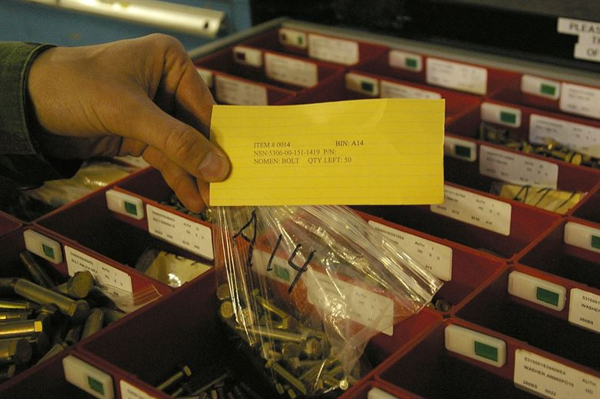
Kanban – Example – Creating 6in6 Presentations
Tailored to 6in6 presentation creation, the Kanban board has 4 categories:
(A) To Do / finding 6in6 topics, (B) creating draft 6in6 presentations (only 1 at a time), (C) reviewing and editing (up to 2) draft presentations, and (D) done.
The first and last columns can contain any number of items.
The WIP limits prevent there from being too many 6in6 presentations in-process.
A push system uses a logistics plan to determine how much product to deliver – which may not reflect reality. A pull system only delivers what is needed.
A Kanban card in a manufacturing environment, which represents a factory order, is at right.
https://www.allaboutlean.com/push-pull/logistic-plan/
https://commons.wikimedia.org/wiki/File:080527-F-0000A-001.JPG
Copyright © 2022-2023 Dan Zwillinger. All rights reserved.

Slide 3
Kanban – Notes
Slide 1
Slide 2
Kanban is a Japanese word meaning “visual sign,” “visual card,” or “signboard.”
Japanese engineer Taiichi Ohno developed Kanban in the 1940s.
The Kanban system creates a smooth, healthy flow. Instead of managing people, you manage the processes and get work through the system faster.
Kanban (method) is not Scrum (framework). For Kanban, value is released when ready. For Scrum, work occurs in sprints.
Benefits of a Kanban system
Ability to quickly respond to changes in the process or customer requirements
Ability to scale the system capacity
Improved delivery speed
Improved dependencies management
Improved predictability of work completion
Increased visibility of the flow
Increased work productivity
Reduction in inventory, handling, and storage.
The top example is for the creation of 6in6 presentations. Only 4 columns are needed since there are only 2 process steps.
The bottom left figure shows the difference between a push and a pull system.
The bottom right figure is Kanban card in a manufacturing environment. When the bag of parts is removed (to be consumed), the card is sent upstream to have another bag delivered.
Copyright © 2022-2023 Dan Zwillinger. All rights reserved.

