Slide 1
Kaizen
Problem
How to improve a product or process?
Difficulty
Work with an SME
Kaizen is a Japanese term meaning change for the better or continuous improvement.
Kaizen can be implemented by many methods: 5S, Six Sigma, CCPM (Critical Chain Project Management), Kanban, PDCA (Plan / Do / Check / Act), TQM (total quality management), …
A Kaizen event or blitz is different, it creates a large change in a fixed time period.
Teamwork
Discipline
Leadership
Kaizen
Approach
Improved product or process
Train and motivate employees.
Identify an improvement opportunity.
Explore new ideas, leveraging employee knowledge and experience.
Define an objective and decompose it into components (e.g., sub-objectives).
Plan the tasks for each sub-objective.
Execute the plan: monitor progress and test results
Start again at step 1.
https://pixabay.com/vectors/umbrella-open-opened-handle-rain-891442/
Copyright © 2024 Dan Zwillinger. All rights reserved.

Slide 2
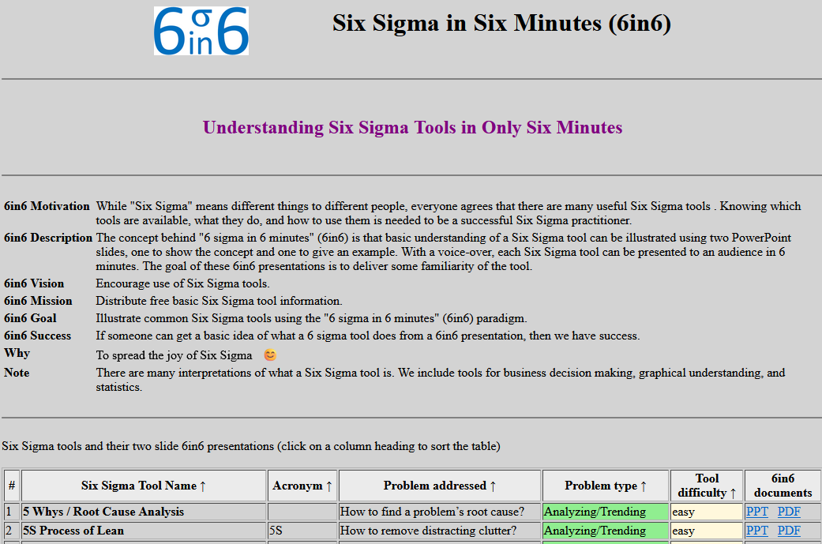
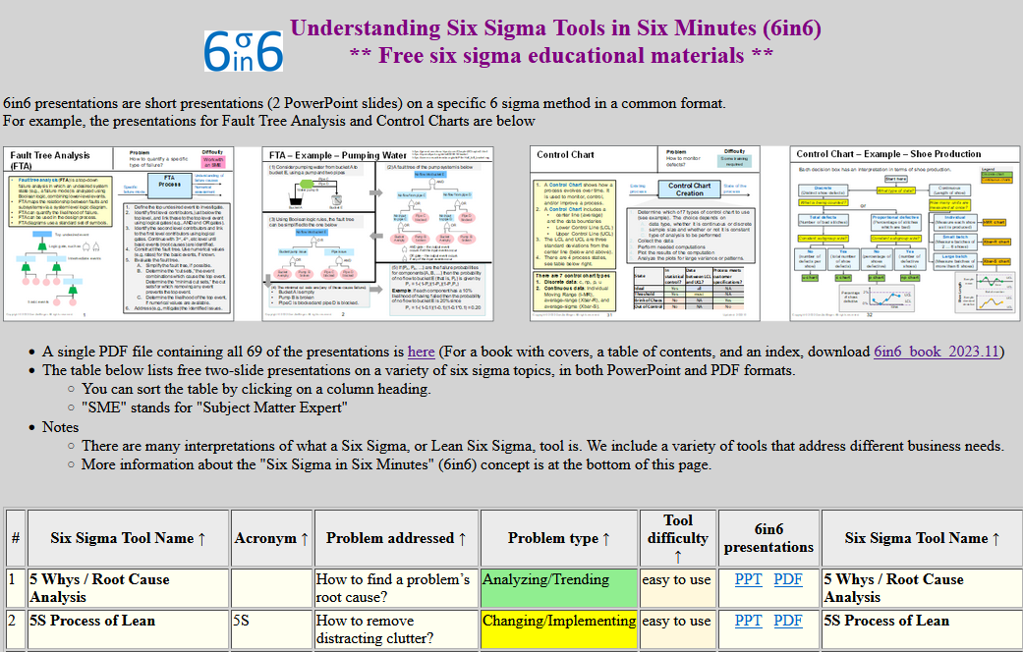
Kaizen – Example – Improve 6in6 web site
Every month look at some part of 6in6 to improve.
  July 2023 → How to improve the “6in6 mission”?
Explore new ideas
  Improve the 6in6 website distributing 6in6 info
Define objective
  Update 6in6 website to current user expectations
Plan the tasks
  Ask friend to critique 6in6 website
  Hire GUI expert to critique 6in6 website
  Implement changes
Execute the plan
  Friend: “Why aren’t there YouTube videos?”
  Hired GUI expert using upwork.com
  Received report which included:
    At the top: too much text
    At the top: reinforce the word “free”
    At the top: give an example deliverable
    Make it look less like a blog
    Didn’t like logo …
  Implemented most of the suggested changes
Repeat
  Aug 2023 → How to make 6in6 info more useful?
    Create “book version” with index …
6in6 web page in June 2022
6in6 web page in January 2024
Copyright © 2024 Dan Zwillinger. All rights reserved.

Slide 3
Kaizen – Notes
Slide 1
Slide 2
The Japanese words, kai 改, and zen 善 mean "change" and “good.”
The Kaizen methodology is that small changes now can have big future impacts.
Kaizen can be applied in multiple ways: Point Kaizen (see a problem and fix it), System Kaizen (system level problems), Line Kaizen (upstream and downstream), Plane Kaizen (address entire value stream), Cube Kaizen (address entire organization).
Before Kaizen, ensure stable operations: machines are working, workers are present, jobs are repeatable, and material is available.
Kaizen involves everyone, from the CEO to the most recent hire.
The five kaizen elements are: know your customer, let it flow, go to Gemba, empower people, and be transparent.
Kaizen may be called lean or agile management.
A static product or process is likely to become less useful over time, continuous change is usually needed.
Things can always be improved. Taiichi Ohno (creator of the Toyota Production System) said “Having no problems is the biggest problem of all.”
Recommended web sites for more information
https://www.appvizer.com/magazine/operations/bpm/kaizen-approach
https://www.investopedia.com/terms/k/kaizen.asp
Copyright © 2024 Dan Zwillinger. All rights reserved.

