Slide 1
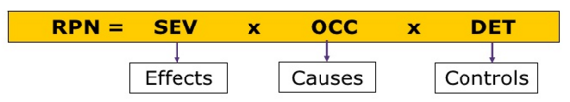
Failure Mode Effects and Analysis (FMEA)
Problem
How to anticipate and mitigate potential problems?
Difficulty
Some training required
FMEA is a systematic, proactive method for evaluating a process
to identify where and how it might fail and
to assess the relative impact of different failures
in order to identify where the process must be changed
FMEAs should be created whenever a failure can result in harm.
System to be analyzed
Failure Mode Effects and Analysis (FMEA) Process
Prioritized list of failure modes
Process owners
Risk reduction strategies
Planning Documents
Process
Determine FMEA type: Defect (FMEA), Design (DFMEA), or Process (PFMEA) and obtain appropriate standardized tables
Identify potential failure modes.
For each failure mode, using standardized tables, assess the following on a 1-10 scale:
Severity rating (how bad it is, if it occurs)
Occurrence rating (how often it will occur)
Detectability rating (how likely it is to be detected, if it occurs)
For each failure mode, multiply the above three numbers (each is between 1 to 10) to obtain a Risk Priority Number (RPN)
For the failure modes with the highest RPN values, determine mitigation strategies
FMEA types include:
Design (DFMEA) focuses on components and subsystems
Process (PFMEA) focuses on manufacturing and assembly processes
Copyright © 2022-2025 Dan Zwillinger. All rights reserved.

Slide 2
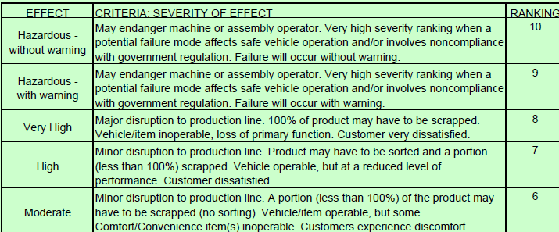
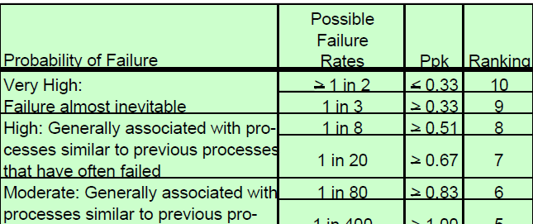
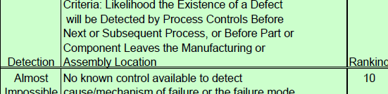
FMEA – Example – Giving a presentation
For simplicity, instead of using values 1 to 10 for {S,O,D}, use the values {1,3,9}}.
The numbers in the grid match the words used.
RPN value is the product of the S, O, D values
List of failure modes
Low RPN values do not need mitigation strategies
High severity – which is bad – gets a 9
High detectability – which is good – gets a 1
Automobile Industry Action Group (AIAG) created the following standards for the North American auto industry
Severity
Likelihood / Occurrence
Detectability
Copyright © 2022-2025 Dan Zwillinger. All rights reserved.

Slide 3
FMEA – Notes
Slide 1
Slide 2
For a given process, FMEA uses a weighted decision matrix to identify the highest risk issues.
The risks – and there can be hundreds – are prioritized so that only the most important ones need to be addressed.
Three values are determined that characterize each risk; they are multiplied together to obtain the RPN. The RPN values are then ordered, largest to smallest.
After risks are identified and prioritized, they can be managed. See the 6in6 presentation on “Risk Analysis & Management.”
This example is for someone giving a presentation. The FMEA analysis is addressing “What can go wrong?”
It is critical to recognize that Severity and Occurrence have a reversed sense from Detection. A large Detectability is good (so the value is 1, say) while a large Severity of Occurrence is bad (so the value is 9, say).
Different industry groups have determined appropriate {S, O, D} value for their industry.
For the AIAG (Automobile Industry Action Group), the “Occurrence” value is
10 if it happens more than half the time
4 if it occurs 1 time in 2,000 potential occurrences.
Risks with low RPN values may not need to be mitigated.
The mitigations identified should be implemented before the process is rolled out.
Recommended web sites for additional information
https://www.6sigma.us/fmea/all-about-failure-mode-and-effects-analysis/
https://www.sixsigma-institute.org/Six_Sigma_DMAIC_Process_Improve_Phase_Failure_Mode_Effect_Analysis_FMEA.php
Copyright © 2022-2025 Dan Zwillinger. All rights reserved.

