Slide 1
Design for Manufacturing & Assembly (DFMA)
Problem
How to make products easy to construct?
Difficulty
Work with an SME
Design for Assembly (DFA)
is concerned with reducing product assembly cost
Design for Manufacturing (DFM)
is concerned with reducing overall part production cost
Preliminary design
Design for Manufacturing & Assembly Process
Improved design
Team
Methodically apply the DFMA principles
Minimize the number of parts
Minimize the use of fasteners
Standardize
Avoid difficult components
Use modular subassemblies
Use multifunctional parts
Minimize reorientations
Use self-locating features
Avoid special tooling
Provide accessibility
Minimize operations & process steps
DFMA has many benefits
Minimizing the number of parts and extra sizes reduces inventory and confusion during assembly
DFMA optimizes trade-offs between assembly, part, and life cycle costs.
Asymmetric part requires alignment
Symmetric part makes assembly easier
Copyright © 2022-2023 Dan Zwillinger. All rights reserved.

Slide 2
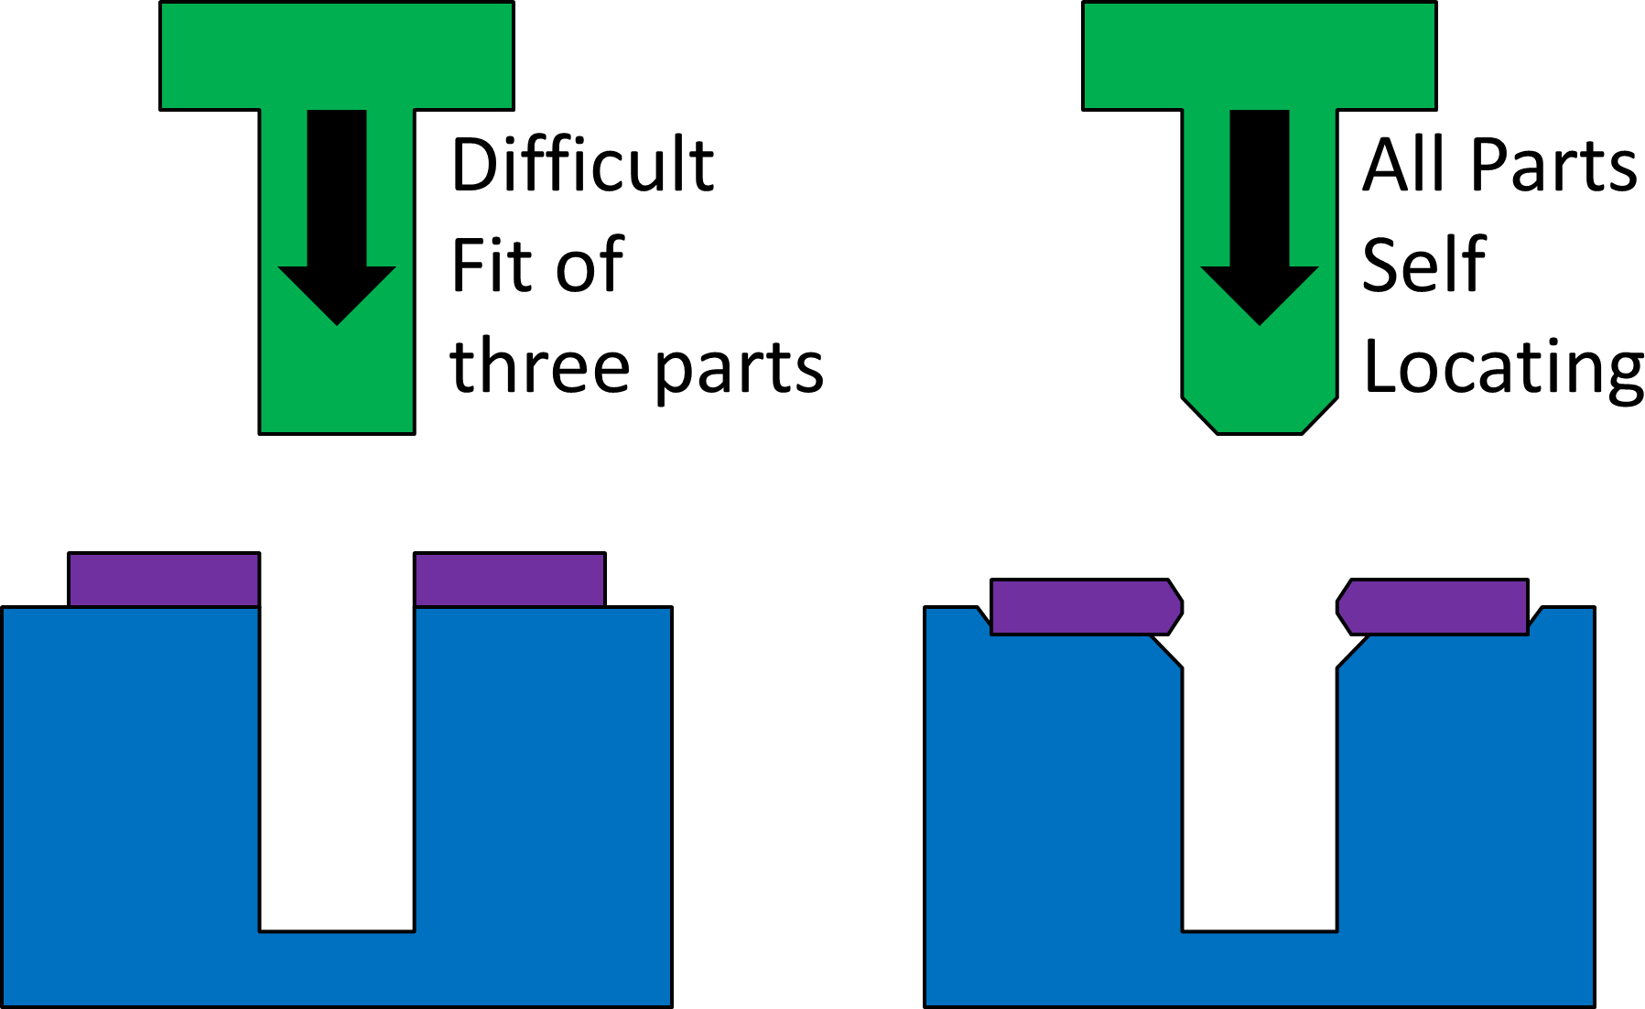
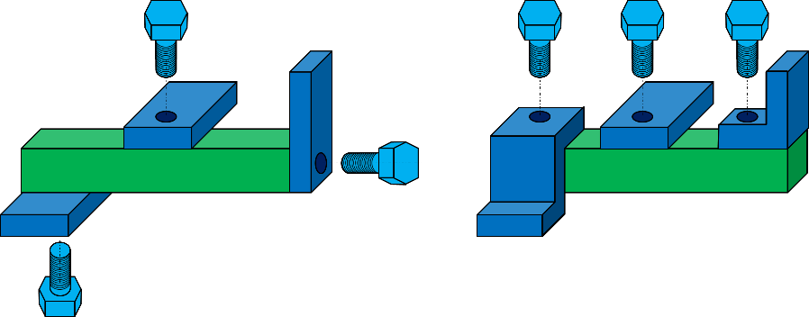
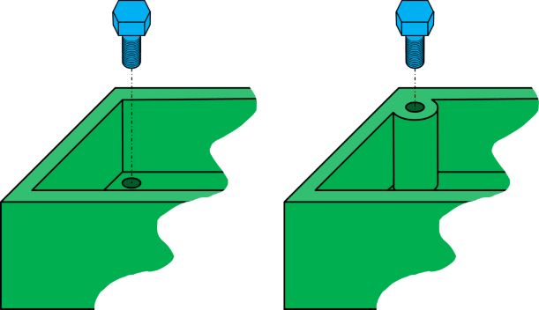
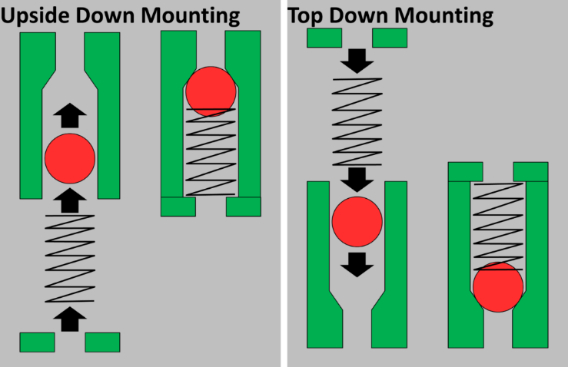
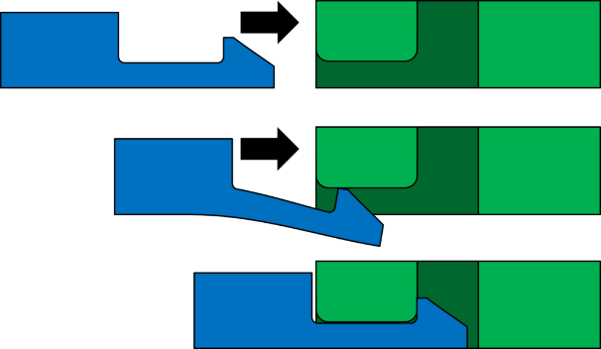
DFMA – Examples – Manufacturing
Make parts self-aligning
Make assembly from one side
Improve access for assembly
Use gravity when possible
Simplify fasteners
Figure credits
https://www.allaboutlean.com/dfma-6/dfma-self-locating-2/
https://www.allaboutlean.com/dfma-6/dfma-upside-down-mounting/
https://www.allaboutlean.com/dfma-6/dmfa-assemble-from-one-side/
https://www.allaboutlean.com/dfma-6/dfma-symmetry/
https://www.allaboutlean.com/dfma-4/dfma-plastic-snap-joint/
Copyright © 2022-2023 Dan Zwillinger. All rights reserved.

Slide 3
DFMA – Notes
Slide 1
Slide 2
DFMA has a set of principles, each reduces the cost of a product’s manufacturability and assembly.
DFMA can be key to profitability.
While the DFMA principles are all simple, and sound simple, seeing examples is the best way to understand their intent.
Asymmetric parts are bad since they may need to be re-aligned during assembly; symmetric parts do not have that issue.
While applying the DFMA principles is straightforward, having a DMFA SME review your improved design is always useful – you may have missed some improvement opportunities.
This page includes several simple examples.
The bottom right image illustrates a simple way to join two pieces.
For each of the other images, the left sub-image is not as good as the right sub-image, from a DFMA point of view.
Copyright © 2022-2023 Dan Zwillinger. All rights reserved.

