Slide 1
Critical Parameter Management (CPM)
Difficulty
Problem
How to identify and manage critical to quality parameters?
Work with an SME
Critical Parameter Management (CPM)
A methodology for ensuring product performance
A mathematical process that links the inputs and outputs, to identify the parameters driving product quality
Critical Parameter Management
Process
Identification of critical parameters
Existing process
Determine the process flow, which must include the inputs, controllable parameters and the outputs of interest. (Typically, the output quality is of interest.)
With the help of an SME:
Using experimental data, mathematically model the input/output relationships.
From the model, determine which controllable inputs have the largest effect on the outputs.
These are the critical parameters
Ensure the process flow properly treats the critical parameters (e.g., by having precise tolerances).
https://commons.wikimedia.org/wiki/File:Calculator_icon.svg
https://commons.wikimedia.org/wiki/File:Antu_mathematica.svg
https://commons.wikimedia.org/wiki/File:Microsoft_Office_Excel_(2019%E2%80%93present).svg
https://commons.wikimedia.org/wiki/File:Matlab_Logo.png
Copyright © 2022 Dan Zwillinger. All rights reserved.

Slide 2
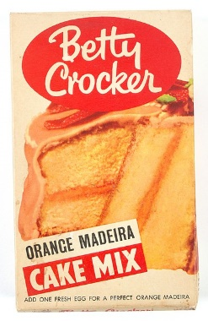
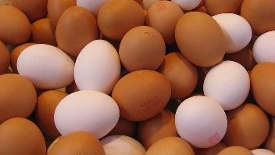
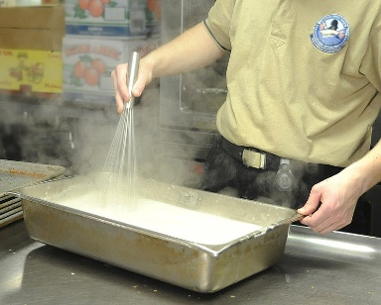
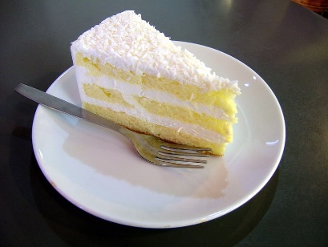
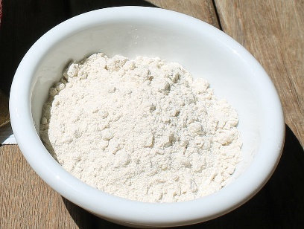
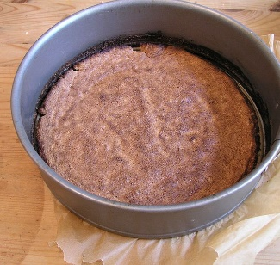
CPM – Example – Cake Mixes
https://commons.wikimedia.org/wiki/File:Packet,_food_product_%28AM_2015.4.51-1%29.jpg
https://commons.wikimedia.org/wiki/File:Egg_texture_169clue.jpg
https://commons.wikimedia.org/wiki/File:Atta_flour.jpg
https://commons.wikimedia.org/wiki/File:Whisking_sauce-01.jpg
https://commons.wikimedia.org/wiki/File:Baking_cake_layer_2.JPG
https://commons.wikimedia.org/wiki/File:A_slice_of_coconut_cake.jpg
From experiments
Cake mixes have essentially one critical parameter: the ratio of flour to baking powder
This ratio is closely monitored during production.
Cake preparation is robust to reasonable variations in:
Quantifies of: water, eggs, oil, cake mix
Cooking environment: time, temperature, humidity
Cake preparation is not robust to altitude. As this is not under the manufacturer’s control, there are separate cooking instructions.
Copyright © 2022 Dan Zwillinger. All rights reserved.

Slide 3
CPM – Notes
Slide 1
Slide 2
The users of a given process often intuitively know which parameters are most important.
To confirm these important parameters, or to identify them, need to create and then analyze a model connecting the inputs to the outputs.
Note that not all system parameters are controllable.
Cake mixes are remarkably robust to how an operator does the preparation and baking – the result is nearly always a good tasting cake.
Figures
https://commons.wikimedia.org/wiki/File:Calculator_icon.svg
https://commons.wikimedia.org/wiki/File:Antu_mathematica.svg
https://commons.wikimedia.org/wiki/File:Microsoft_Office_Excel_(2019%E2%80%93present).svg
https://commons.wikimedia.org/wiki/File:Matlab_Logo.png
Figures
https://commons.wikimedia.org/wiki/File:Packet,_food_product_%28AM_2015.4.51-1%29.jpg
https://commons.wikimedia.org/wiki/File:Egg_texture_169clue.jpg
https://commons.wikimedia.org/wiki/File:Atta_flour.jpg
https://commons.wikimedia.org/wiki/File:Whisking_sauce-01.jpg
https://commons.wikimedia.org/wiki/File:Baking_cake_layer_2.JPG
https://commons.wikimedia.org/wiki/File:A_slice_of_coconut_cake.jpg
Copyright © 2022 Dan Zwillinger. All rights reserved.

