Slide 1
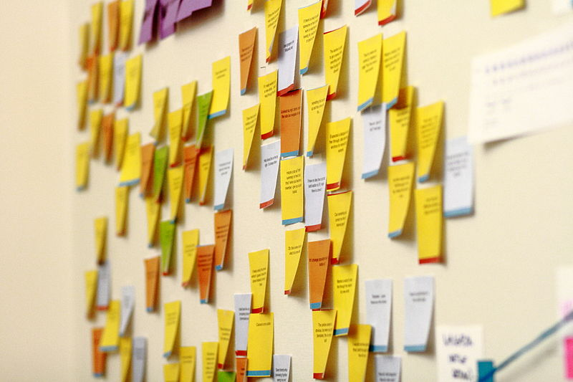
Brainstorming
Problem
How to identify ideas to solve a problem?
Difficulty
Easy to use
Brainstorming is a way to generate many ideas or solutions to a problem or issue.
Brainstorming rules:
There are no bad ideas.
Don’t discuss any ideas.
Don’t criticize any ideas.
Encourage people to build on other people’s ideas.
Encourage quantity over quality.
Team
Brainstorming process
Problem to address
List of ideas
Define the problem or issue to be addressed. It may be a “why,” “how,” or “what” issue.
Perform the brainstorming – multiple options:
People write their ideas on sticky notes.
For unstructured brainstorming, have people call out ideas, and the leader writes them on sticky notes.
For round-robin brainstorming, ask each person in turn for an idea (they can pass)
Capture all ideas in an area visible to all.
Stop when no one has any more ideas.
Put the ideas into groups and eliminate duplicates (this can also be done during the session)
https://commons.wikimedia.org/wiki/File:Sticky_notes_on_the_wall_of_the_Wikimedia_Foundation_office,_2010-10-26.jpg
Copyright © 2022-2024 Dan Zwillinger. All rights reserved.

Slide 2
Brainstorming – Example – Generic
The grouping can be done during, or after, the brainstorming session.
The prioritization is done after the brainstorming session.
Copyright © 2022-2024 Dan Zwillinger. All rights reserved.

Slide 3
Brainstorming – Notes
Slide 1
Slide 2
For issues with some sensitivity, have people privately create many ideas on sticky notes for a fixed period of time (5-10 minutes). Then the leader can compile them into a single list.
In “go away and come back” brainstorming, a brainstorming session can last days. At their convenience, people review what others have posted and build on what is there, or add new ideas.
With a large team, you can start a brainstorming session by capturing a few high level concept areas. Then break into smaller teams with each team focusing on one of those concept areas.
Some isolated ideas may not fit into any of the groups. If they are not themselves useful, then they can be discarded.
Recommended web sites for more information
https://leansigmafocus.com/the-4-rules-of-brainstorming/
Copyright © 2022-2024 Dan Zwillinger. All rights reserved.

