Slide 1

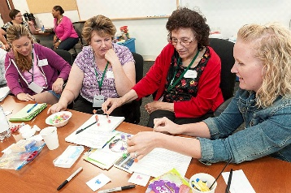
Body Storming
Difficulty
Problem
How to improve thinking about a product or process?
Some training required
Body storming, a form of brainstorming, creates user empathy and leads to re-design.
A body storming exercise combines role-play and simulation. It uses prototypes and observations of how users interact with products to understand the user experience.
There is no standard body storming process, the process is tailored to each specific circumstance.
Body Storming
Process
Early thinking about a product or process
Improved thinking based on user experiences
Define the issue/product/process to be examined.
View the issue location and observe:
How people behave at this location.
The artifacts people interact with.
Define a scenario to be explored.
Assemble an appropriate team.
Run the body storming exercise:
Follow the defined scenario
Capture relevant info (e.g., people’s behavior)
Optional: Replay scenario using info gained.
Gather the participants’ subjective experiences
Analyze the results and take appropriate actions.
Abstract brainstorming
Hands on Brainstorming
https://commons.wikimedia.org/wiki/File:Business-colleagues-having-meeting-in-conference-KS674JC.jpg
https://commons.wikimedia.org/wiki/File:Working_together_%289598967879%29.jpg
Copyright © 2022-2024 Dan Zwillinger. All rights reserved.

Slide 2
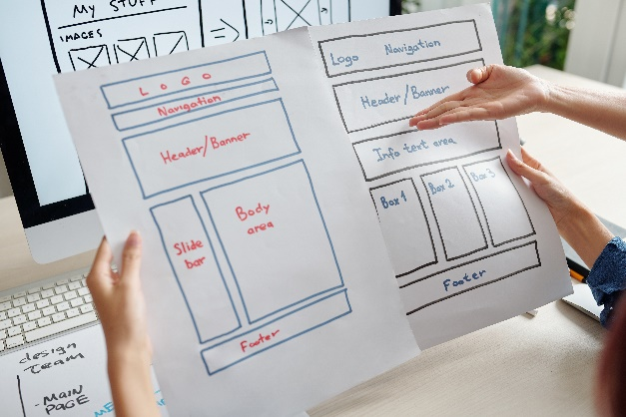
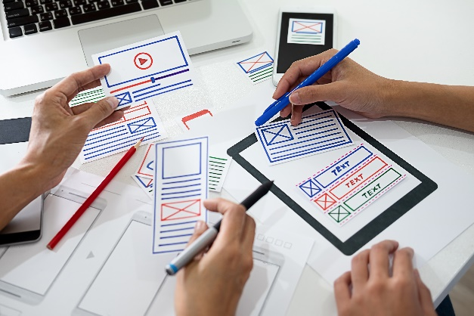
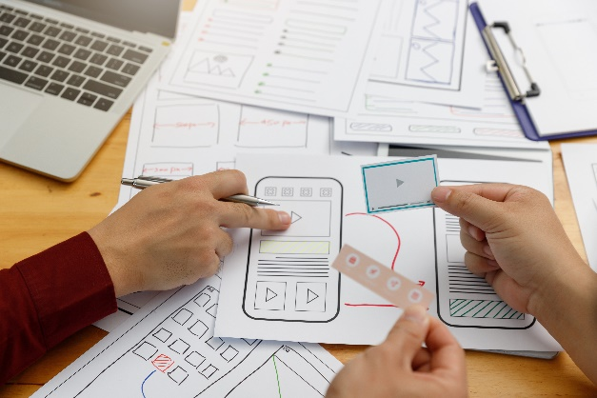
Body Storming – Example – User Interfaces
Paper prototyping is a form of body storming. For user interfaces, paper prototyping is a way to develop ideas and design user flows using hand-created images. Paper prototypes evaluate the user experience more than the design itself.
Initial interface design
Paper instantiation
Body storming exercise
Users “push” icons and the facilitator appropriately changes the paper model.
Revise interface design
User interface evaluation process
Observe 3-5 different people attempting to use the interface.
The facilitator changes the paper model in response to user activities.
Update the design, as needed, to align the design with user expectations
Copyright © 2022-2024 Dan Zwillinger. All rights reserved.

Slide 3
Body Storming – Notes
Slide 1
Slide 2
Body storming is an ideation method.
Body storming is not prototyping.
Body storming is not user testing.
Body storming can test new solutions, leading to needed re-design.
Body storming is different from role play since the researcher sees the same conditions as the user.
Body storming is used in the early stage of a design which needs to incorporate a customer’s viewpoint.
Body storming
Pros: empathy with users, first hand user experience, obtain users’ help with design
Cons: discomfort for some users, requires people skills and sensitivity, time consuming
A body storming exercise can be used for nearly any design.
User interfaces:
A common need is to design a user interface – which is abstractly presented in this example.
It is critical that users attempt to use the prototyped interface without any coaching.
Recommended web sites for more information
https://www.benchmarksixsigma.com/forum/topic/39272-bodystorming/
Copyright © 2022-2024 Dan Zwillinger. All rights reserved.

