Slide 1
A3 report
Problem
How to document a project?
Difficulty
Easy to use
An A3 report summarizes important information about an improvement project.
There is no standard content for an A3 report, although it is typically aligned with PDCA (Plan-Do-Check-Act).
The A3 report fits on a single page, on paper of size A3.
A3 reports can be used during project performance, or at project completion.
Team
A3 report process
Problem to address
List of ideas
Obtain template for your company’s A3 report, or use one from the web. (It likely has ~7 categories such as the ones shown below left.)
For each category, show the important information using text and/or graphics.
Prominently display the A3 report for team and management review, and for educational purposes.
Copyright © 2022-2023 Dan Zwillinger. All rights reserved.

Slide 2
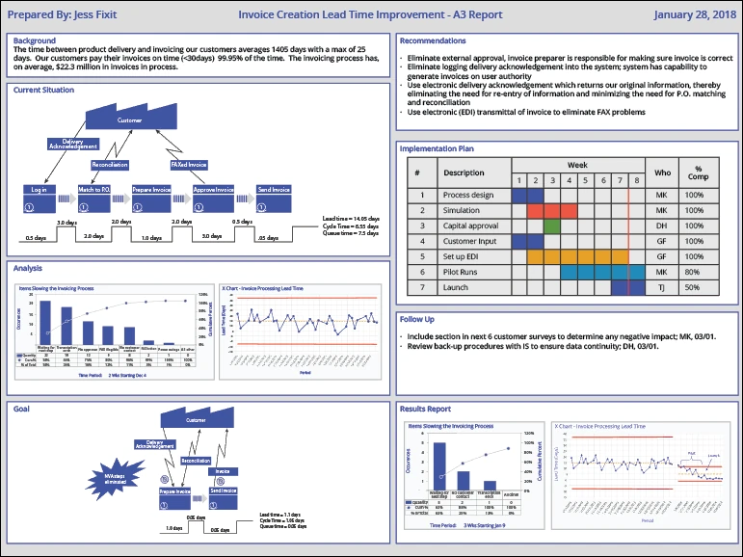
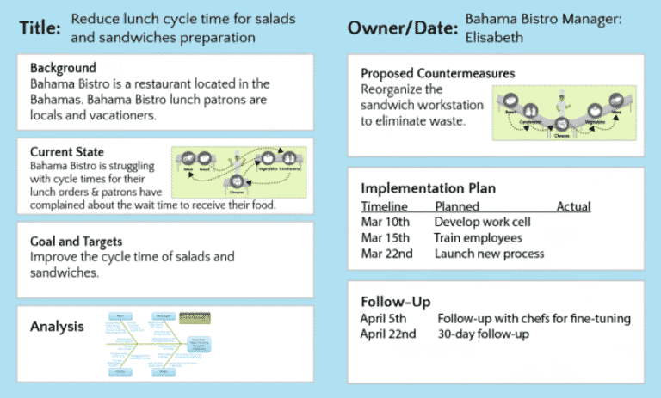
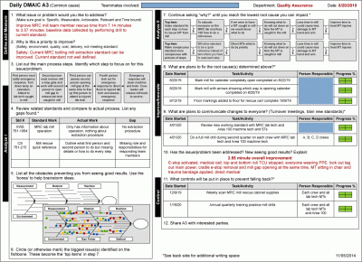
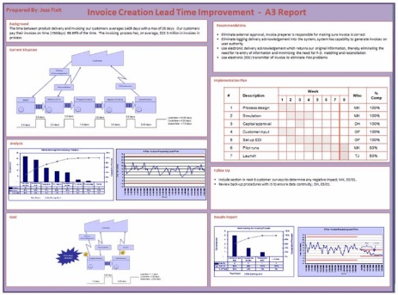
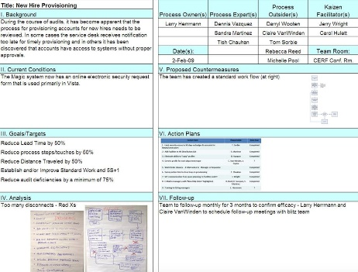
A3 report – Examples from the web
Each company has its own A3 formatting style
Some web examples
Background
Recommendations
Current Situation
Implementation Plan
Analysis
Follow Up
Goal
Results Report
Figure credits
https://www.moresteam.com/lean/a3-report.cfm
https://www. https://www.leansixsigmadefinition.com/glossary/a3/
https://goleansixsigma.com/john-shook-grand-daddy/
https://goleansixsigma.com/4-new-ways-to-use-a3s-have-you-tried-any-of-these/
https://www.isixsigma.com/operations/manufacturing-operations/improved-rescue-time-from-a-bolling-mill-machine/attachment/a3-project-summary/
Copyright © 2022-2023 Dan Zwillinger. All rights reserved.

Slide 3
A3 report – Notes
Slide 1
Slide 2
Toyota developed the A3 concept as part of its production system.
The A3 size is 297 millimeters by 420 millimeters or approximately 11 by 17 inches.
The A3 approach is most suited to the completion of relatively short Kaizen improvement tasks.
A3 report benefits:
It has the same information for each project
It avoids (too) long PowerPoint presentations.
It facilitates communication among stakeholders, documenting results with data.
It (often) shows data visually and is (usually) easily understood.
It can educate others in how to execute an improvement project.
The examples show that graphics are often used. When text is used, often very few words are used for each category.
The examples show a wide variety in how projects are documented.
The largest example, left, documents an improvement project on invoicing. It contains:
a value stream mapping for both the current and desired states
a timeline of the improvements made
a histogram and trend analysis – for both the initial state and the improved state
Copyright © 2022-2023 Dan Zwillinger. All rights reserved.

